Slide 1
Welcome To York Code Dojo
Yorkdevelopers.org
@yorkdevelopers
@yorkcodedojo

Slide 2
Agenda
Quick Introduction
Explain the problem
Work in pairs till 8.45pm
Opportunity to show off solutions
Pub about 9pm

Slide 3
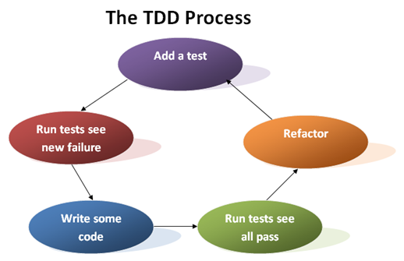
Notes:
Who knows what TDD is?
Who has done TDD before?

Slide 4
Demo
Notes:
Word count
No words
1 words
Multiple words

Slide 5
Tonight’s Problem
Aim
Technique
Word wrap
Work in pairs
Notes:
Aim - Trying TDD is more important that solving the problem
Technique - Don’t think about how you are going to solve it.
Requirements - If in doubt look at how notepad works
Pairs - Work in pairs, ping-pong. One writes the test, the other writes the code. Then swap

Slide 6
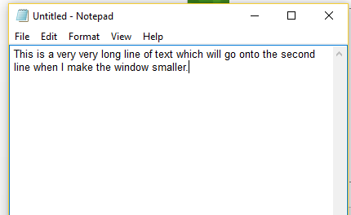
Code

